Slide 1

Wearables: other functional approaches
JSM 2019

Slide 2
Overview
Multi-level functional methods
Matrix-variate multi-level functional methods
Multi-level methods for generalized (e.g binary) functional curves
Registration of generalized (e.g. binary) functional curves

Slide 3
Multi-level functional principal component analysis (MFPCA)

Slide 4
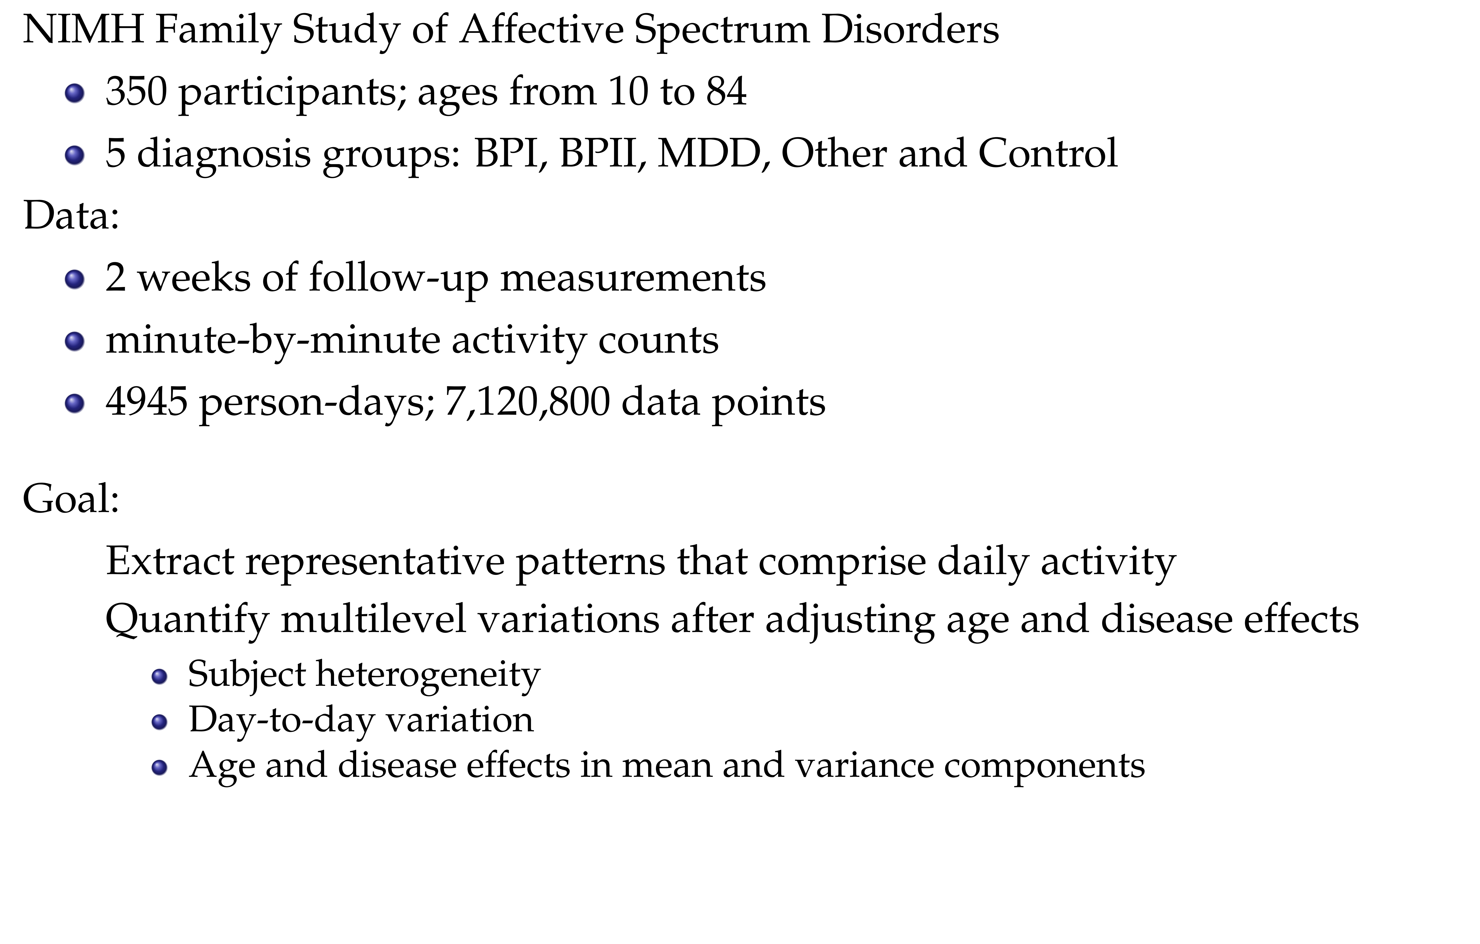

Slide 5
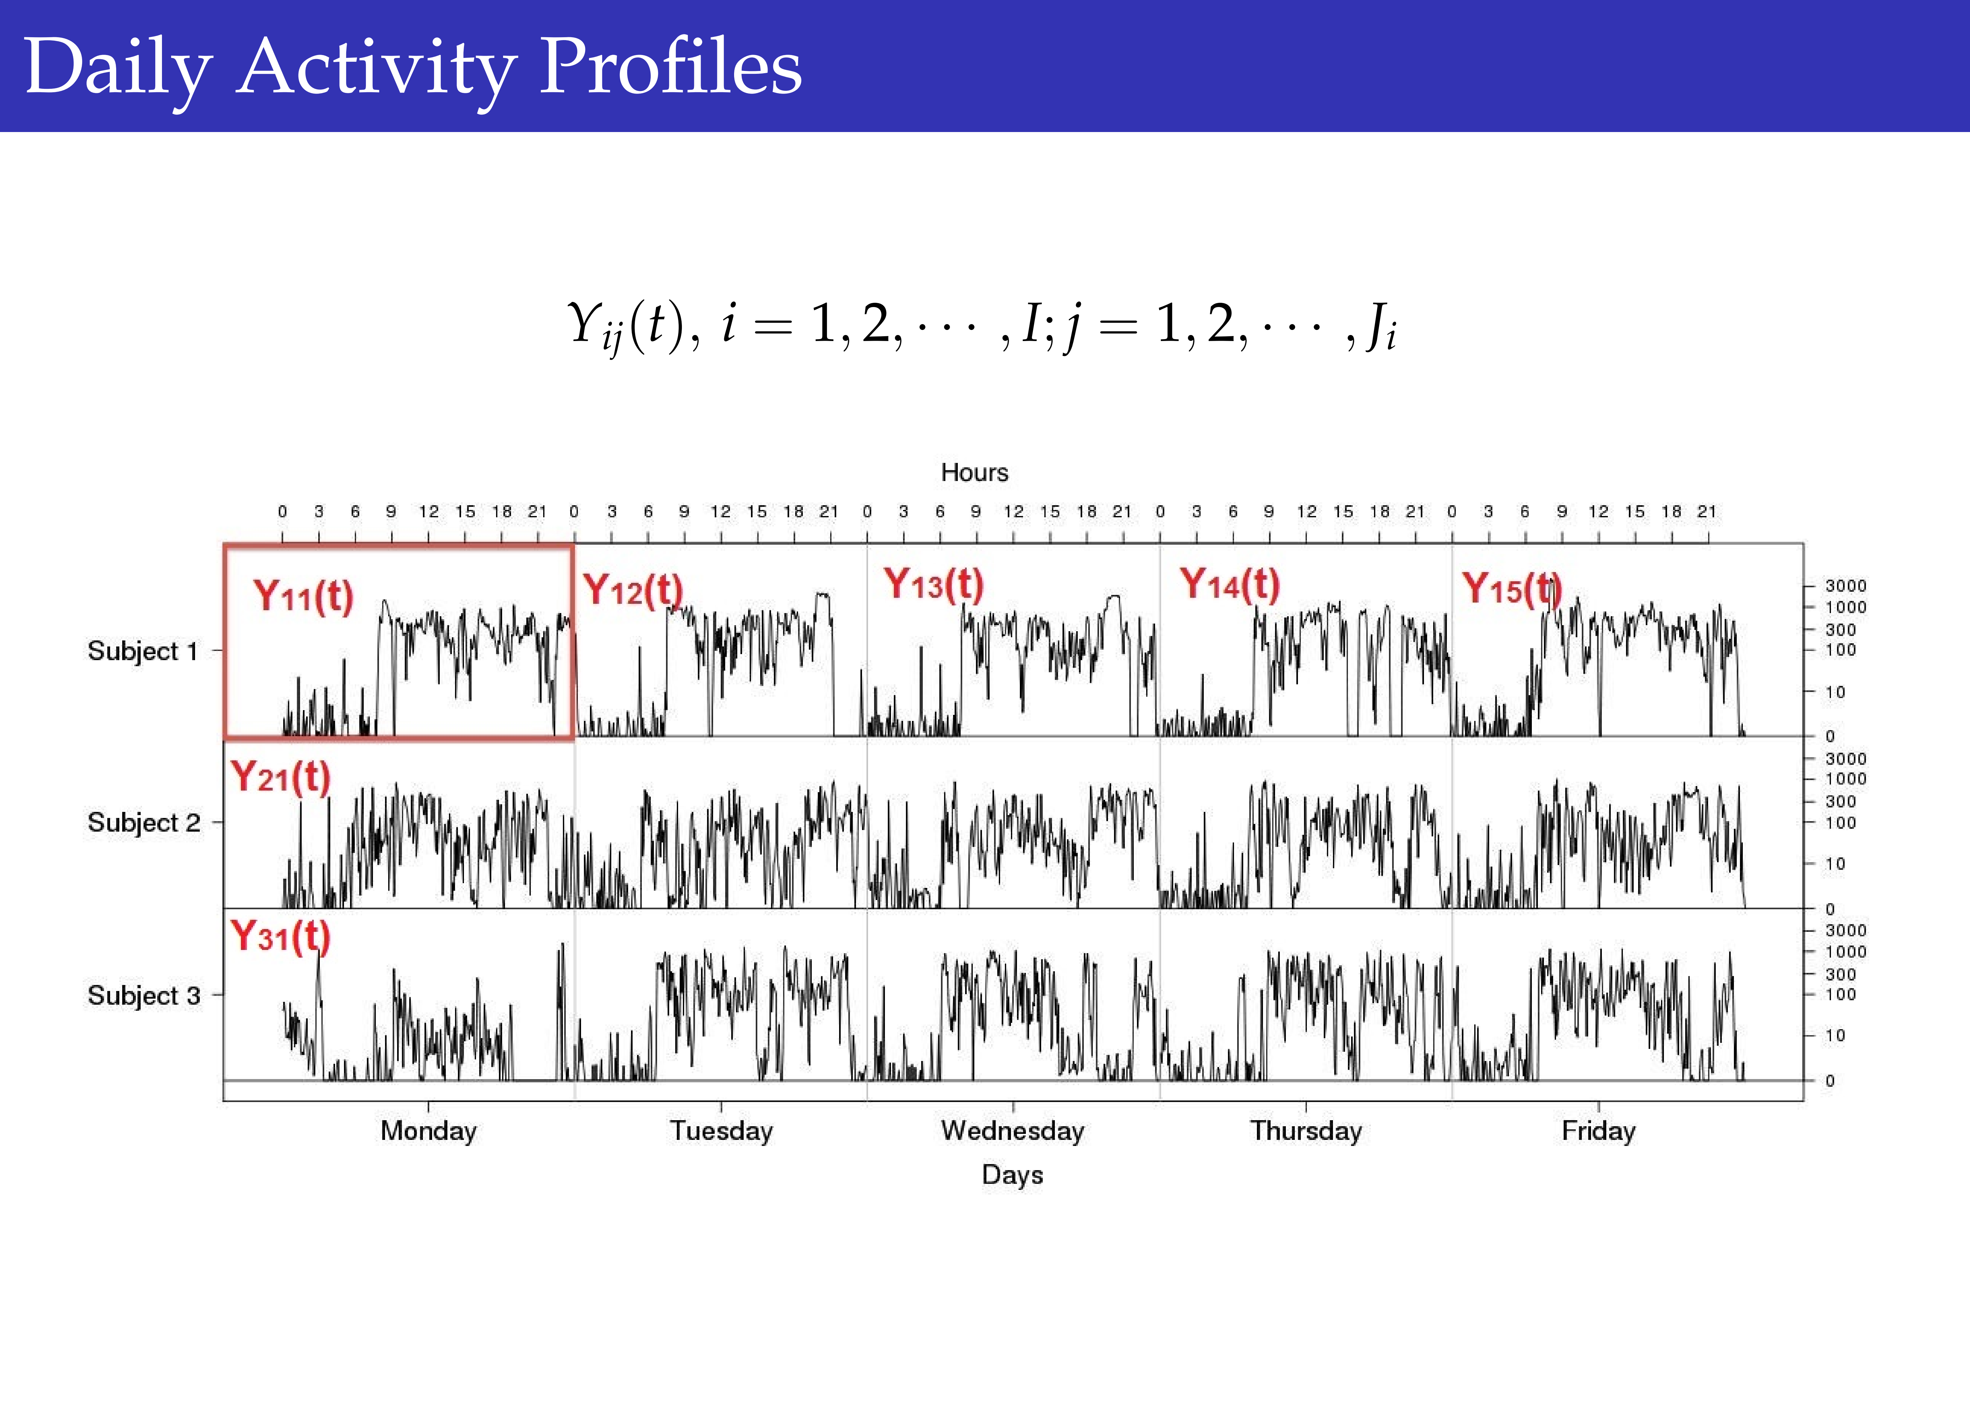

Slide 6
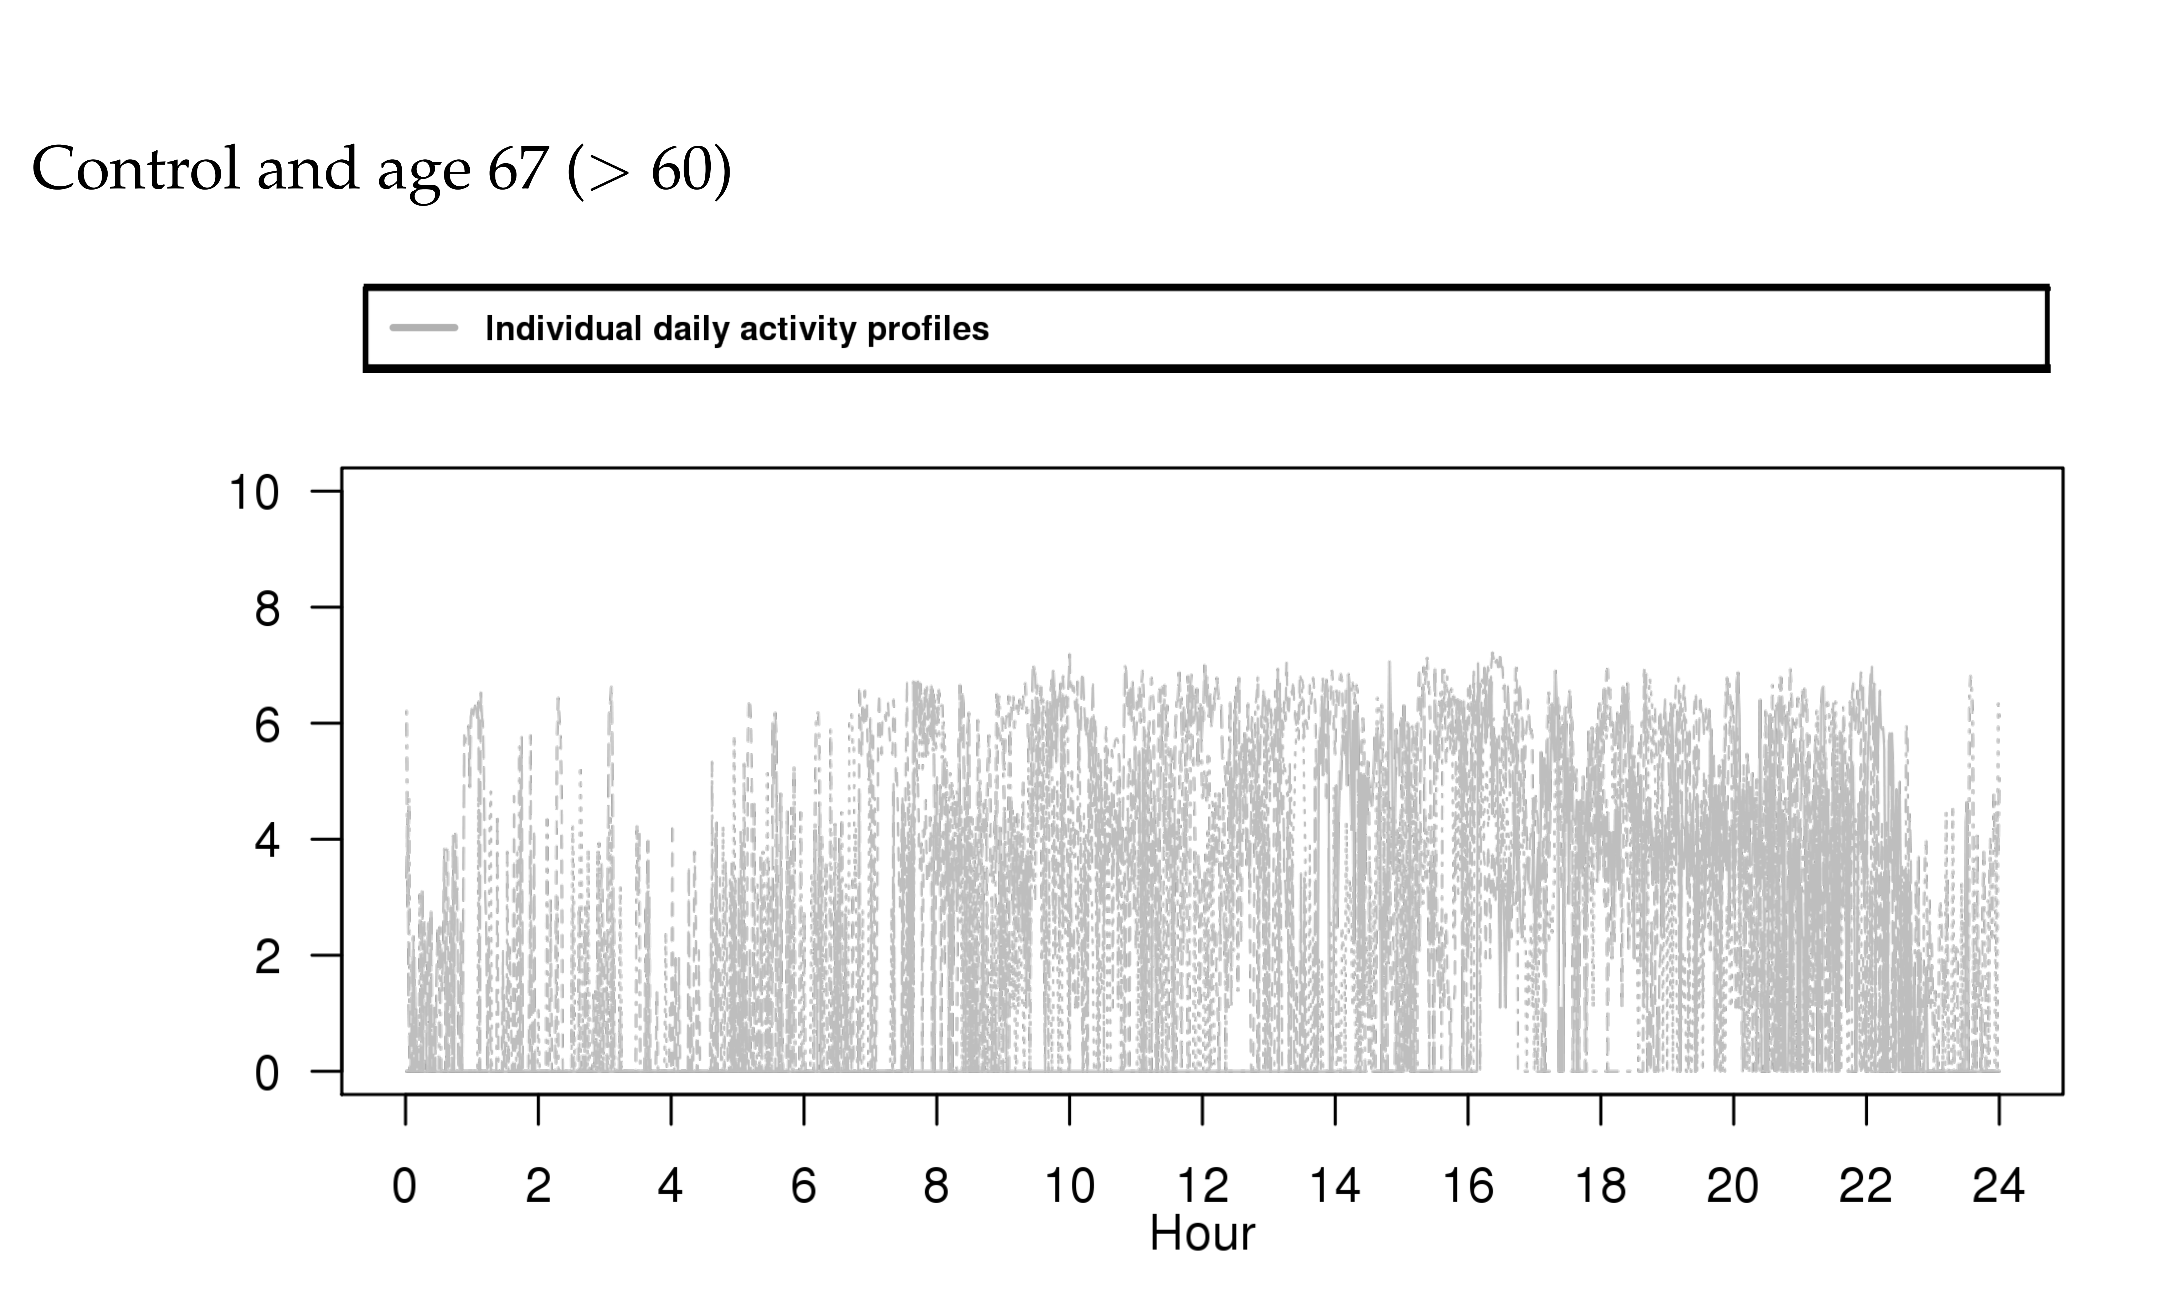

Slide 7
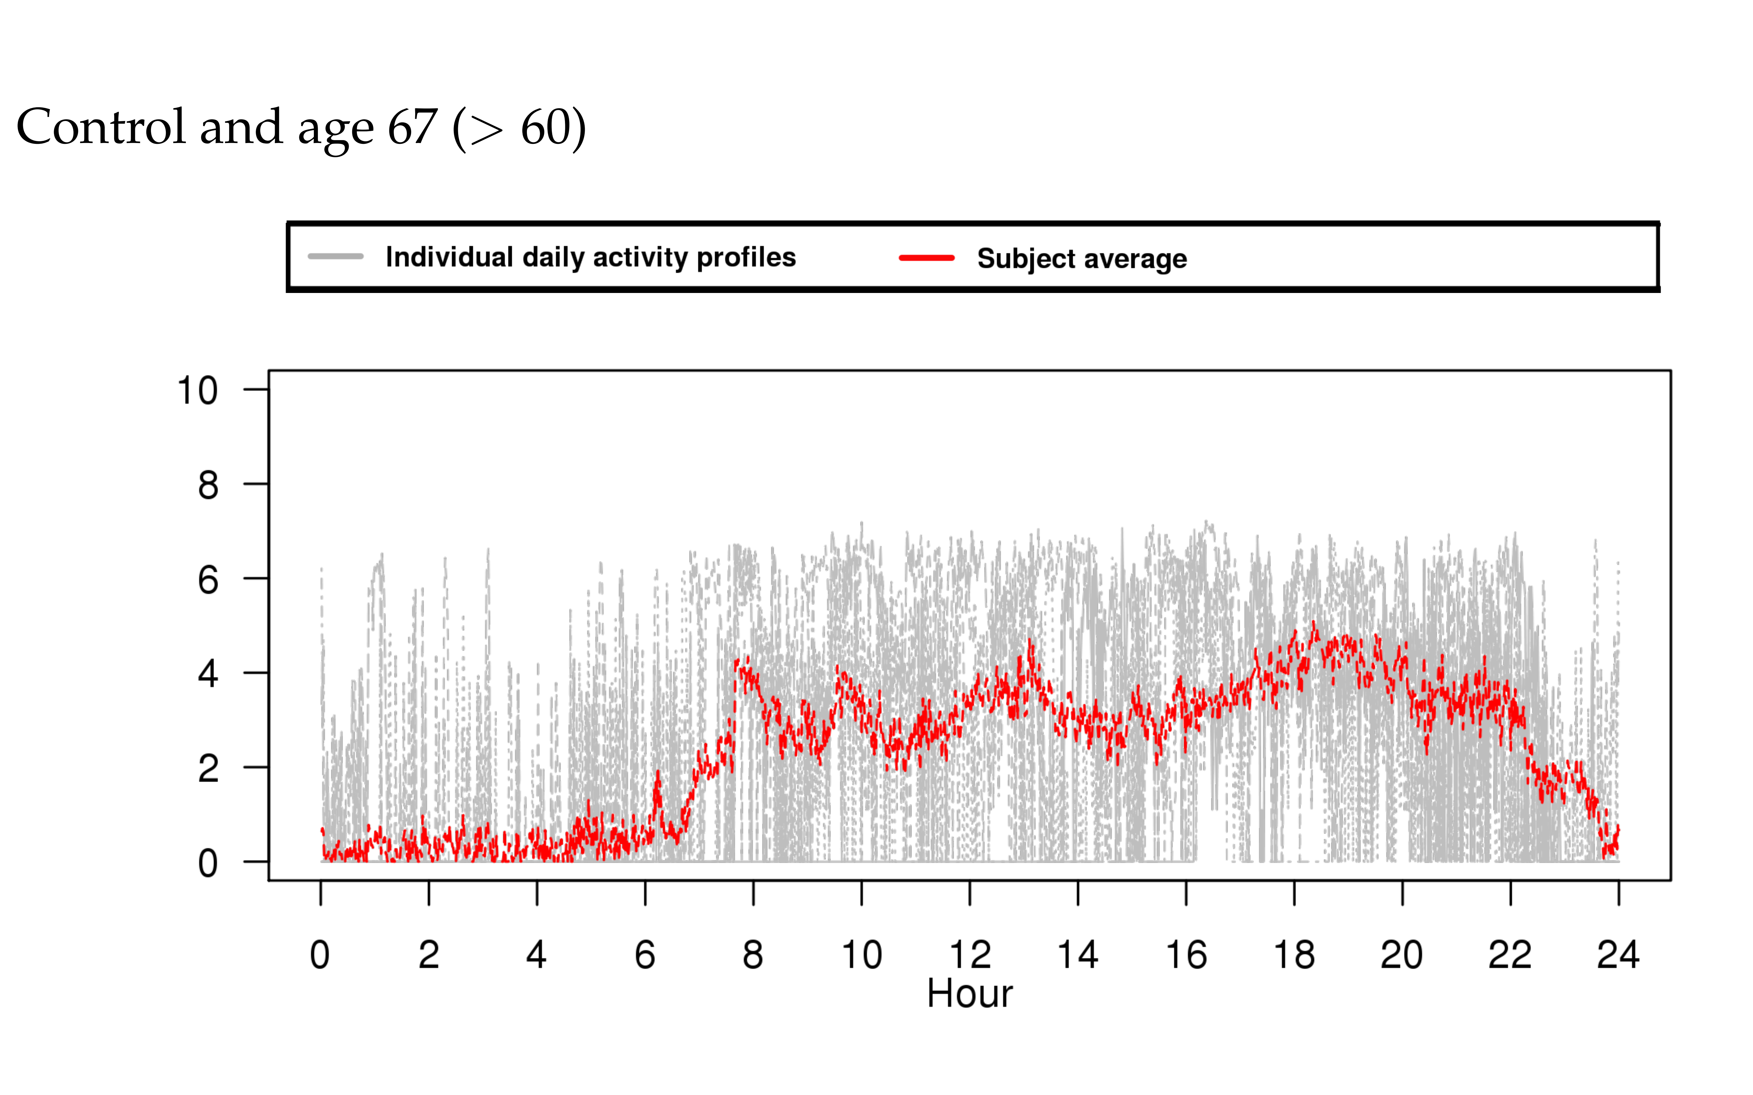

Slide 8
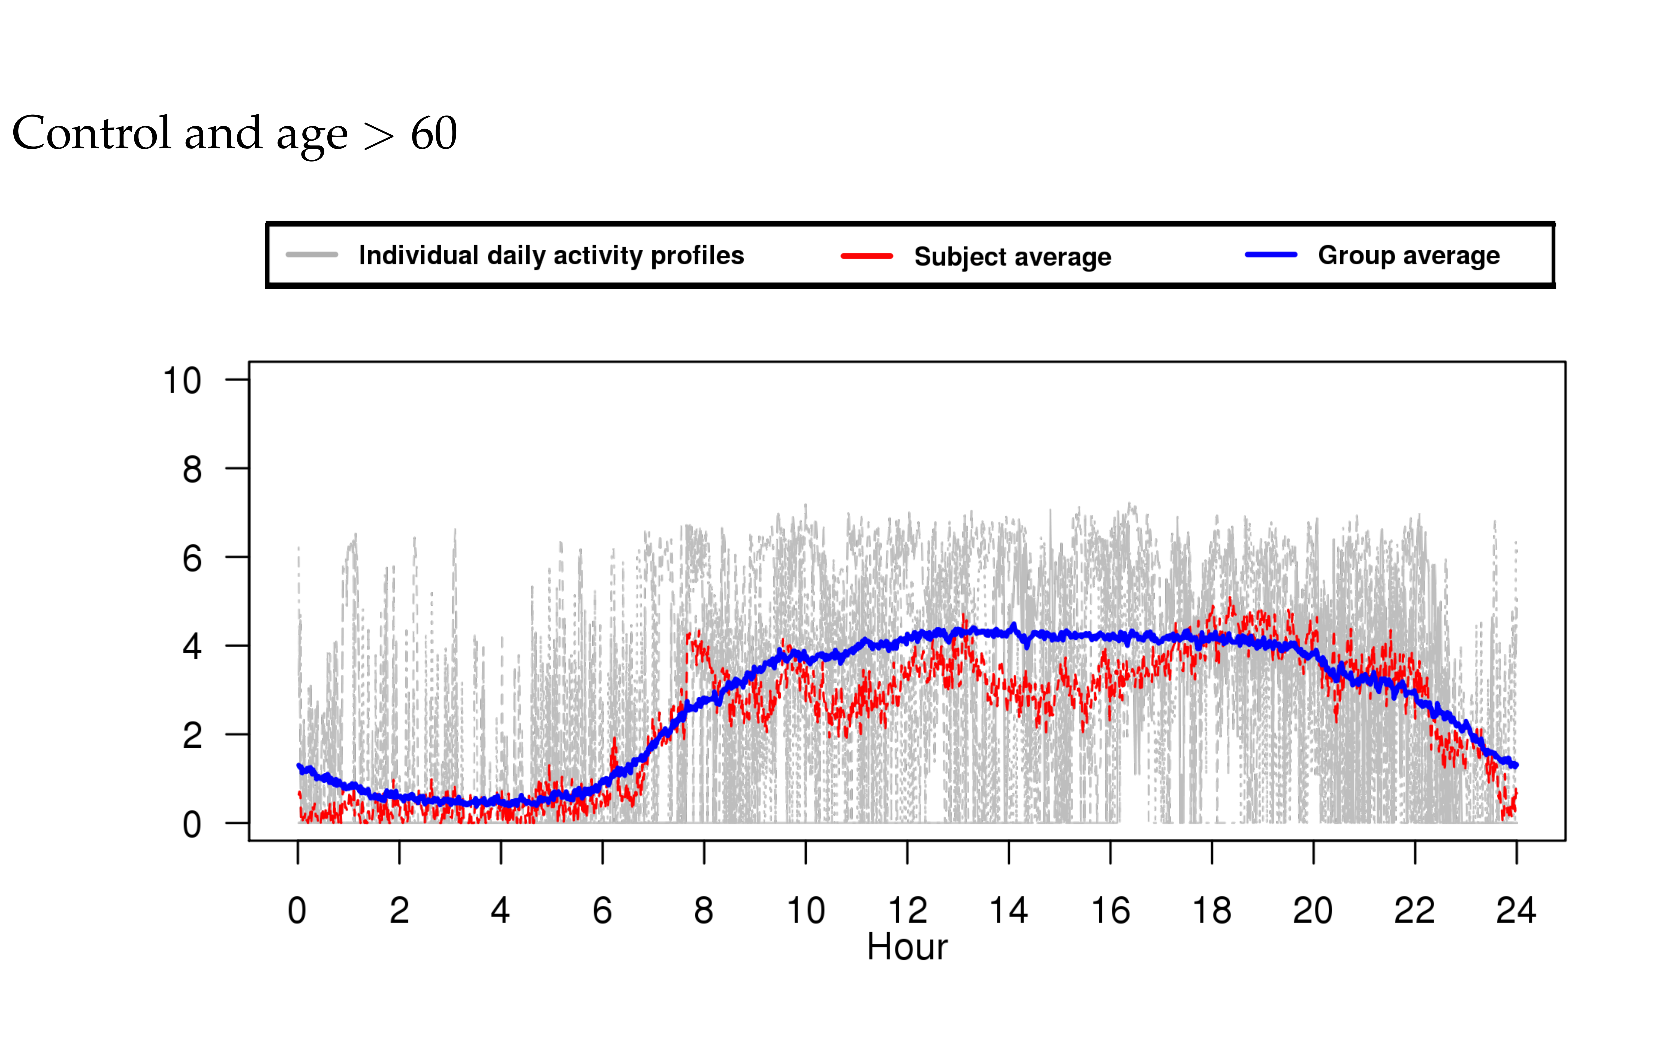

Slide 9
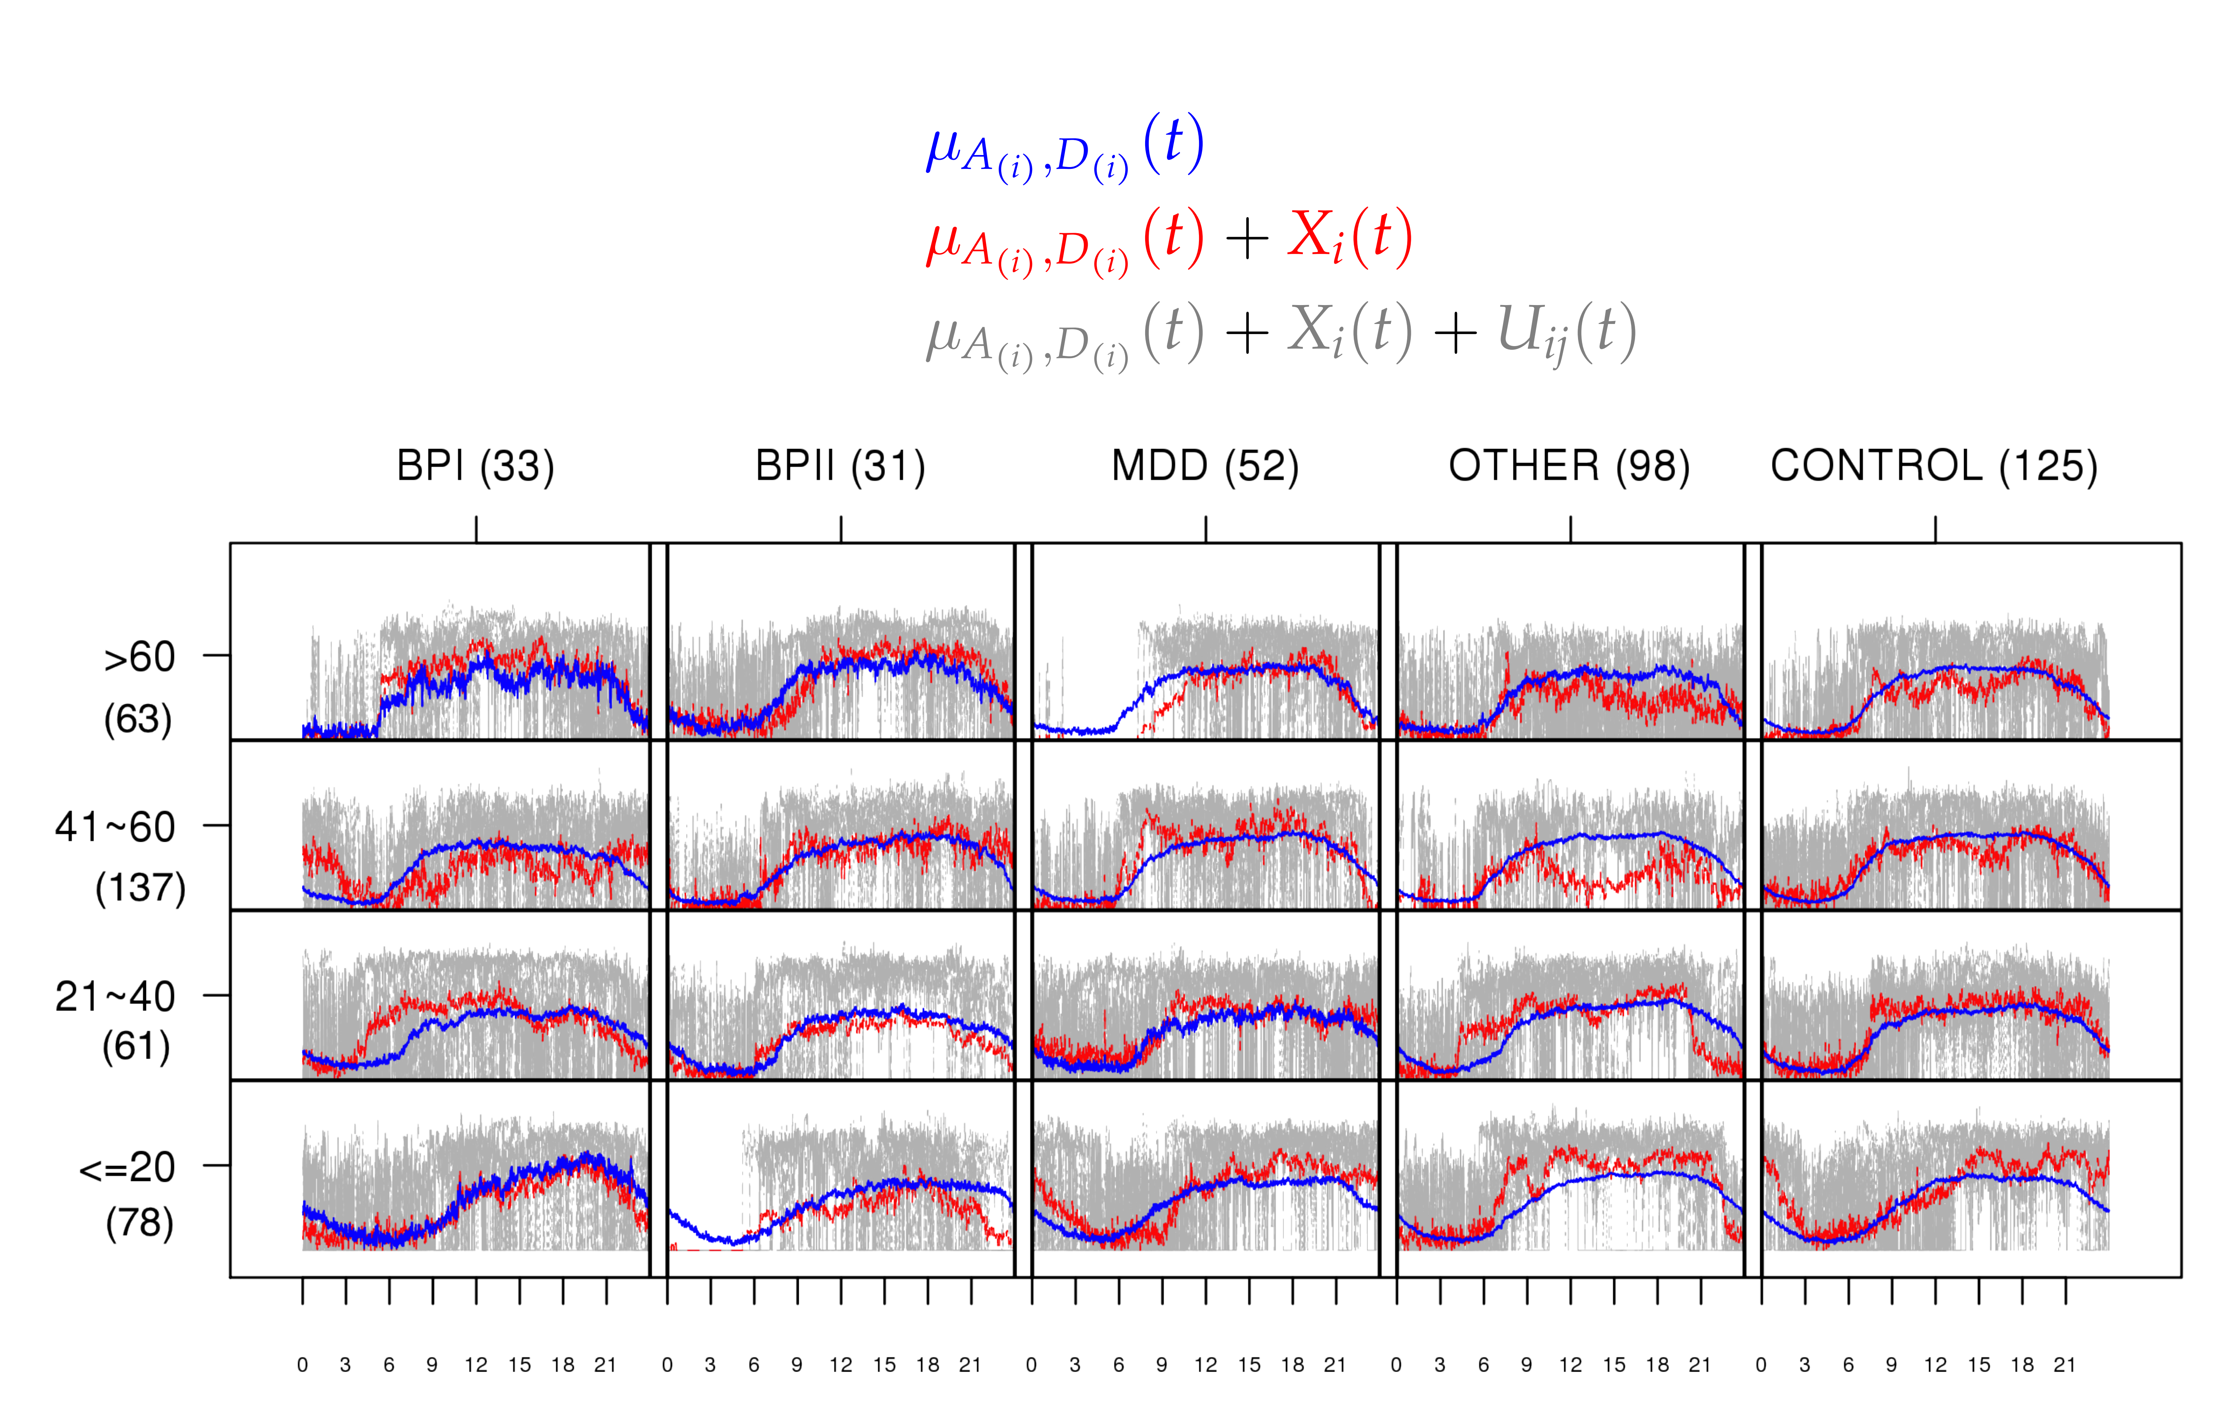

Slide 10
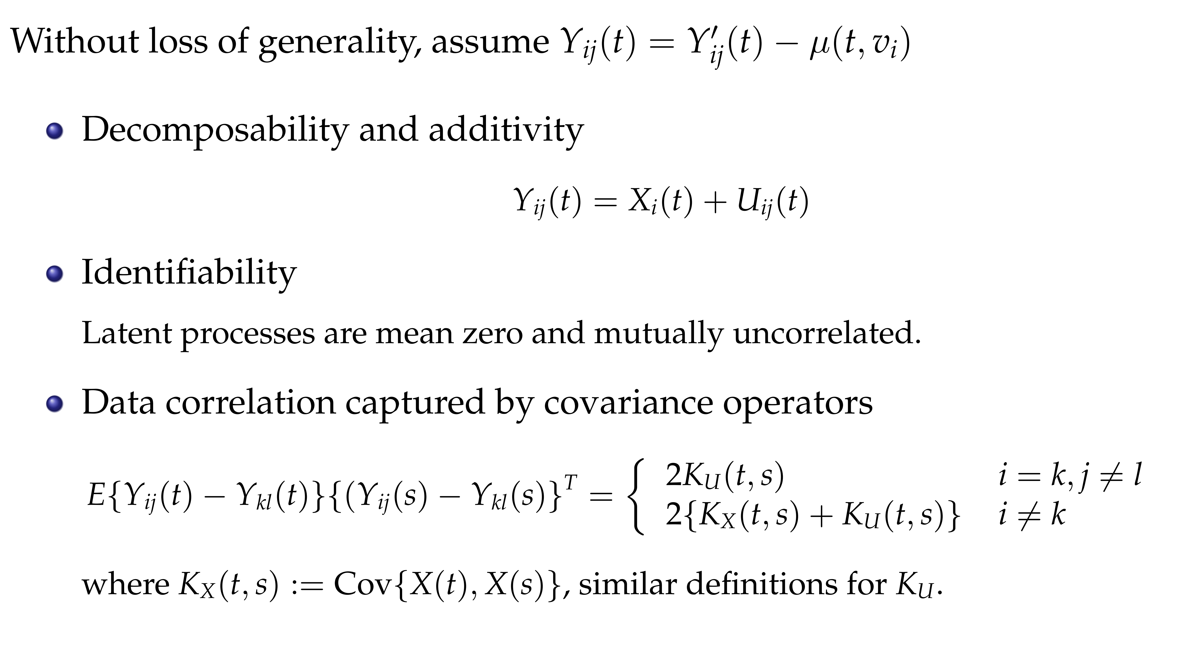

Slide 11
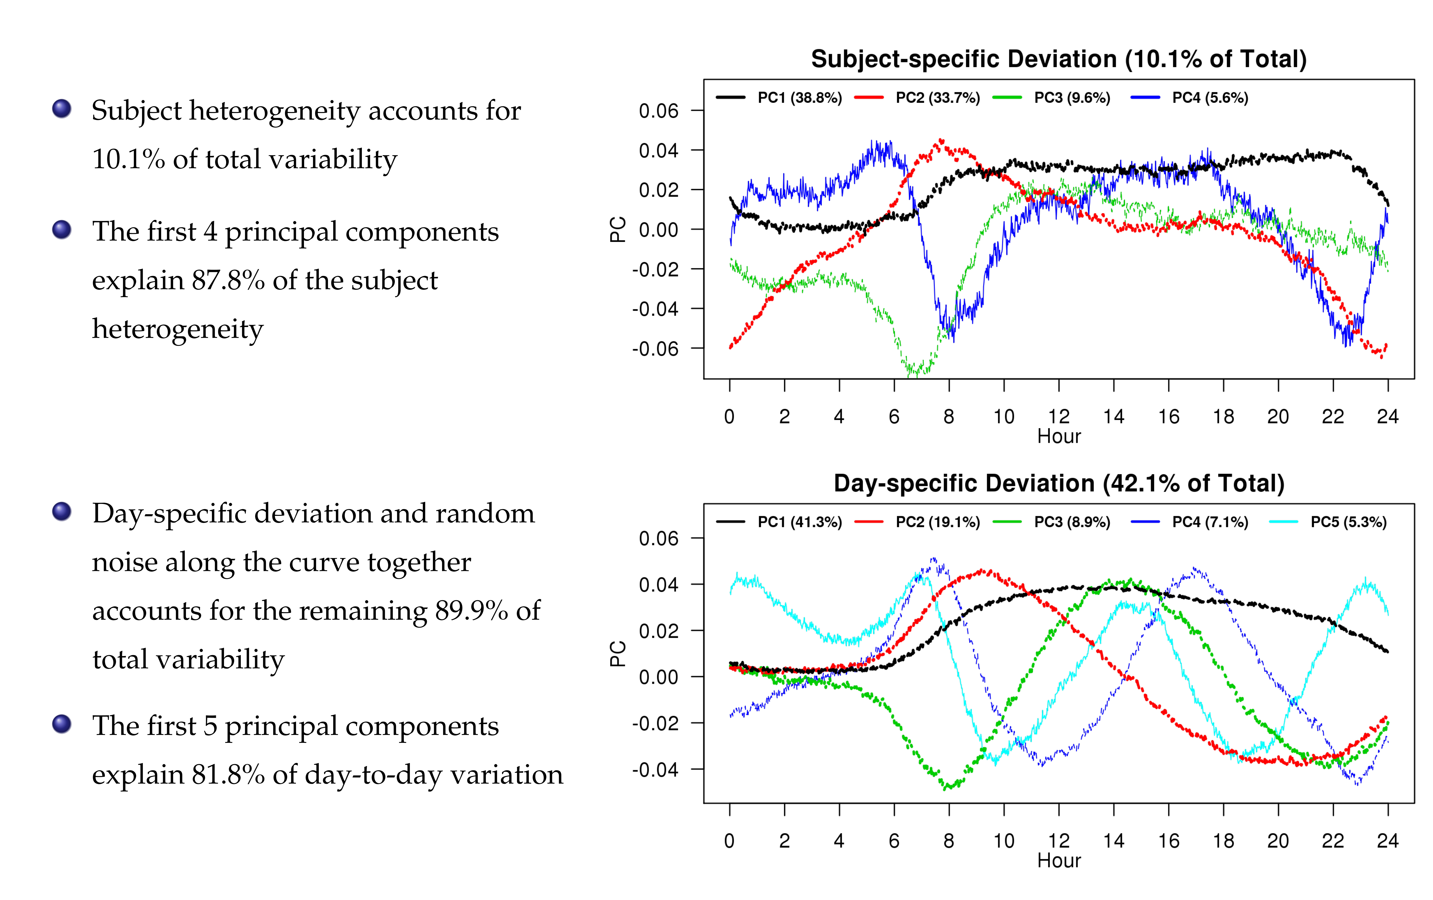

Slide 12
References
Di, C.Z., Crainiceanu, C.M., Caffo, B.S. and Punjabi, N.M., 2009. Multilevel functional principal component analysis. The annals of applied statistics, 3(1), p.458.
Zipunnikov V., Caffo B.S., Yousem D.M, Davatzikos C., Schwartz B.S., Crainiceanu C. (2011),Multilevel Functional Principal Component Analysis for High-Dimensional Data. Journal of Computational and Graphical Statistics, 20(4), pp. 852-873
Shou, H., Zipunnikov, V., Crainiceanu C., Greven, S. (2015) Structured Functional Principal Component Analysis Biometrics, 71 (1), pp. 247-757

Slide 13
Multi-level Matrix-Variate Analysis (MMVA)

Slide 14
Background
Heart failure (HF) is a leading chronic disease in the elderly
Lifetime risk is 20% for those over age 40 in the US
HF burden exceeds $30 billion (> 50% on hospitalization costs)
Identifying subjects with increased risk of hospitalization is important

Slide 15
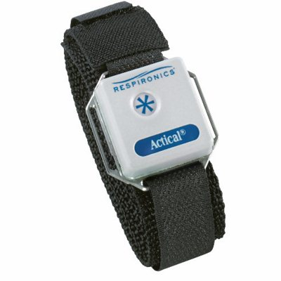
Background
Static risk models include demographics, comorbidities (AFib, hypertension, diabetes mellitus), income, etc.
Dynamic risk models may be more accurate by including real-time data from wearables
A prospective longitudinal cohort study Advanced Cardiac Care Center of Columbia University Medical Center
59 individuals with clinical diagnosis of congestive heart failure (CHF)
3-9 months of follow up
Actical (Respironics)
up to one month of minute-level activity counts

Slide 16
Background
24 individuals had adverse clinical events
14 hospitalizations
10 emergency room visits
Goal: model within-subject pre/post event change in patients status
Solution: track week-to-week variability

Slide 17
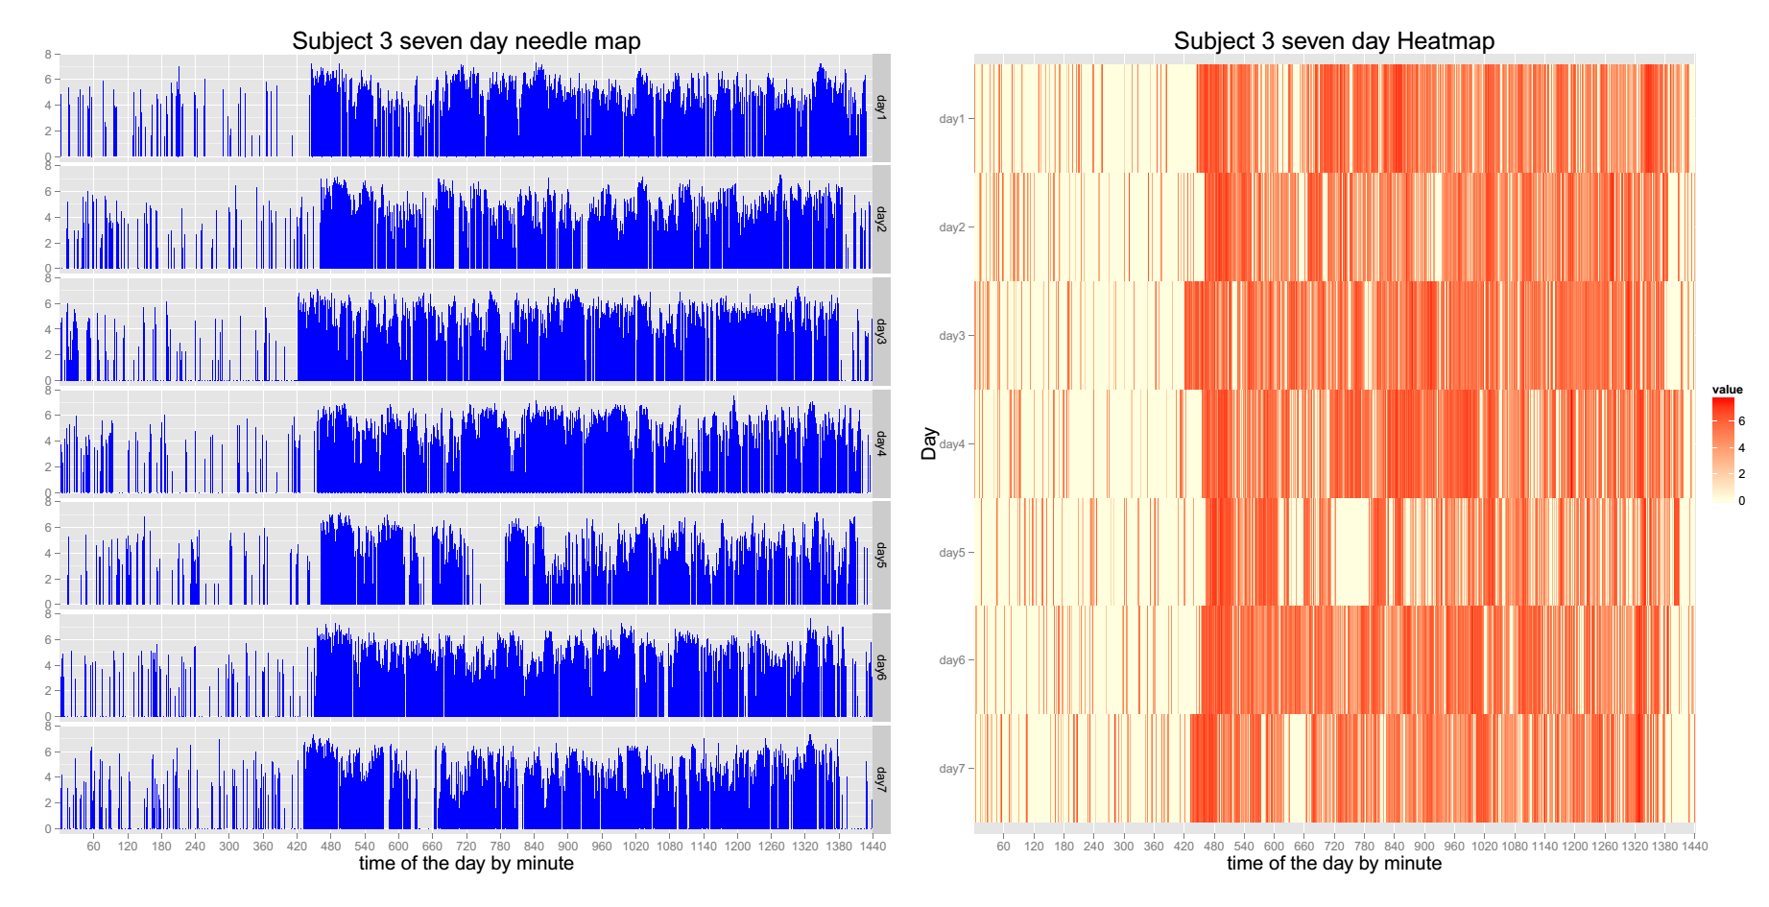
Minute-level activity profiles

Slide 18
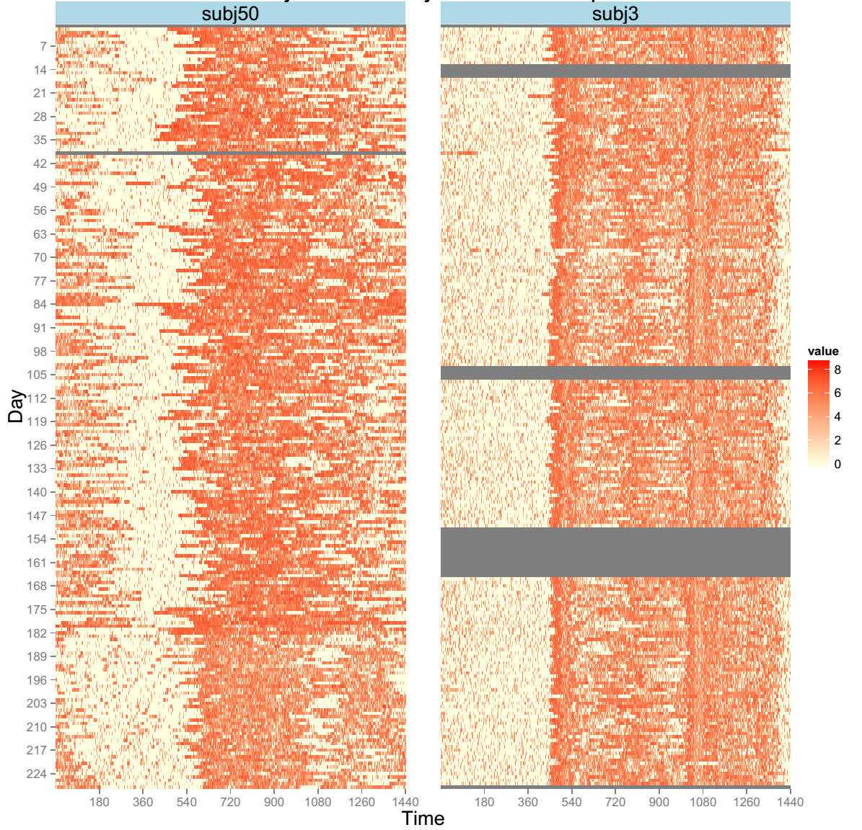
No-event group subject
- 8 months of monitoring
Low week-to-week variability
Had no hospitalizations
Notes:
Aim: to quantify the week to week variability

Slide 19
Event-group subject
- 8 months of monitoring
High week-to-week variability
Had a hospitalization
Notes:
Aim: to quantify the week to week variability

Slide 20
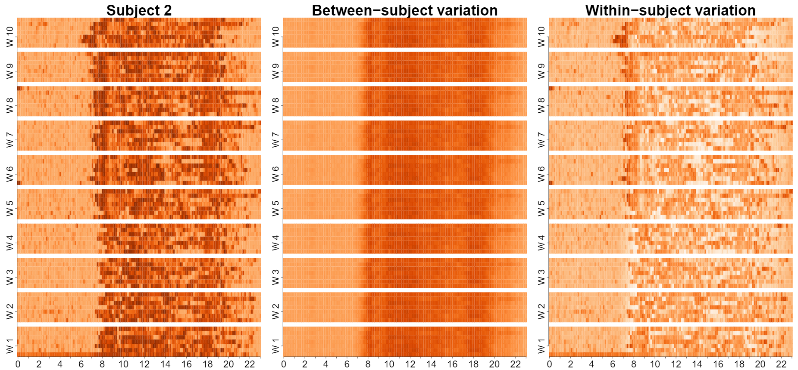
Multilevel Matrix-Variate Analysis (MMVA)
Keep within-week temporal structure across days & within-day
Models subject-specific week-to-week variability
uses a linear mixed effect model to account for the multilevel design
2D structure is handled via a matrix-variate distribution
Notes:
Give some background on NHANES, day of the week and the time of the day;

Slide 21
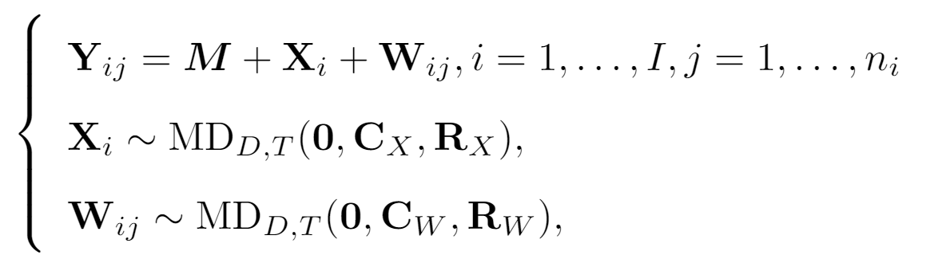
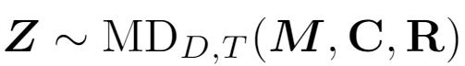


MMVA
Model:
Z follows a matrix-variate distribution:
if
Normal matrix-variate distribution
Notes:
Add things about representing in terms of the basis

Slide 22
MMVA
Between-subject matrix-variate distance
Within-subject matrix-variate distance

Slide 23
MMVA
Between-subject scores can be used as a “static” biomarker to enrich and potentially improve accuracy of currently used “static" risk score models.

Slide 24
MMVA
Within-subject scores can be used as “dynamic” biomarkers that inform about weekly changes in patient status.

Slide 25
Reference
Huang, L., Bai, J., Ivanescu, A., Harris, T., Maurer, M., Green, P. and Zipunnikov, V., 2019. Multilevel matrix-variate analysis and its application to accelerometry-measured physical activity in clinical populations. Journal of the American Statistical Association, 114(526), pp.553-564.
Data is freely available with the submission

Slide 26
Multi-level Generalized Function-on-Scalar Regression and Principal Component Analysis

Slide 27
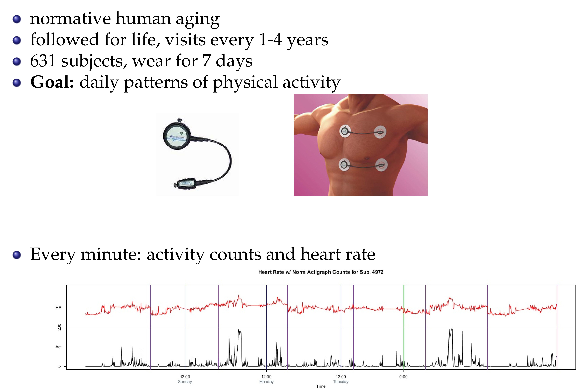

Slide 28
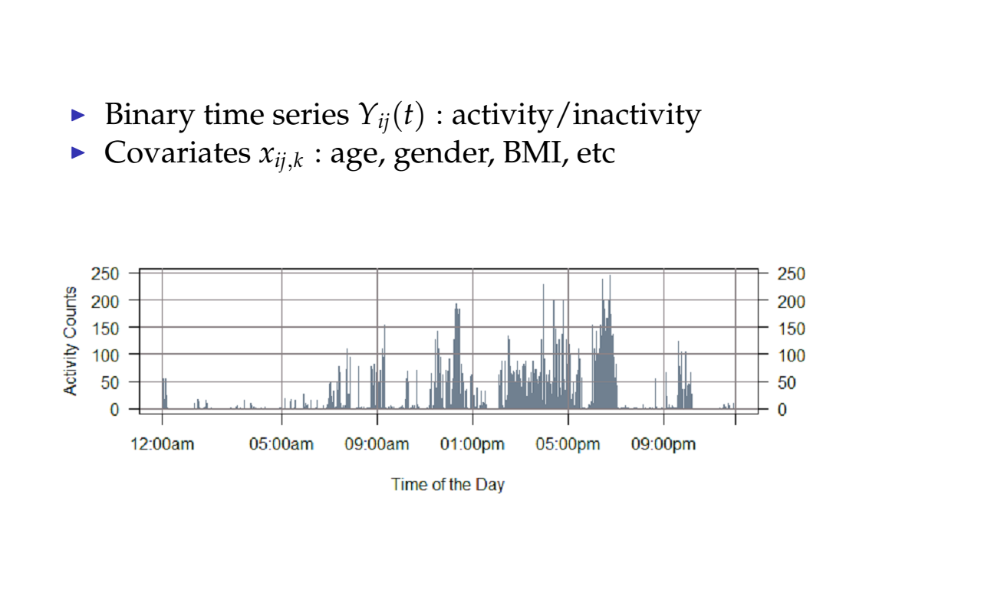

Slide 29
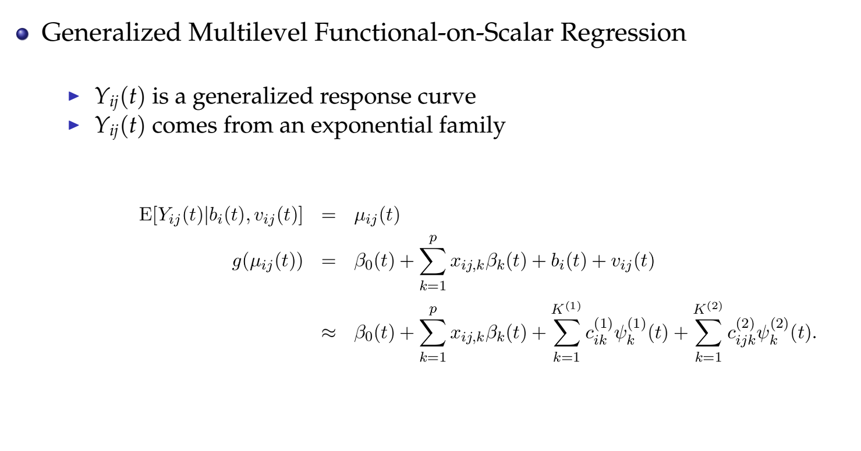

Slide 30
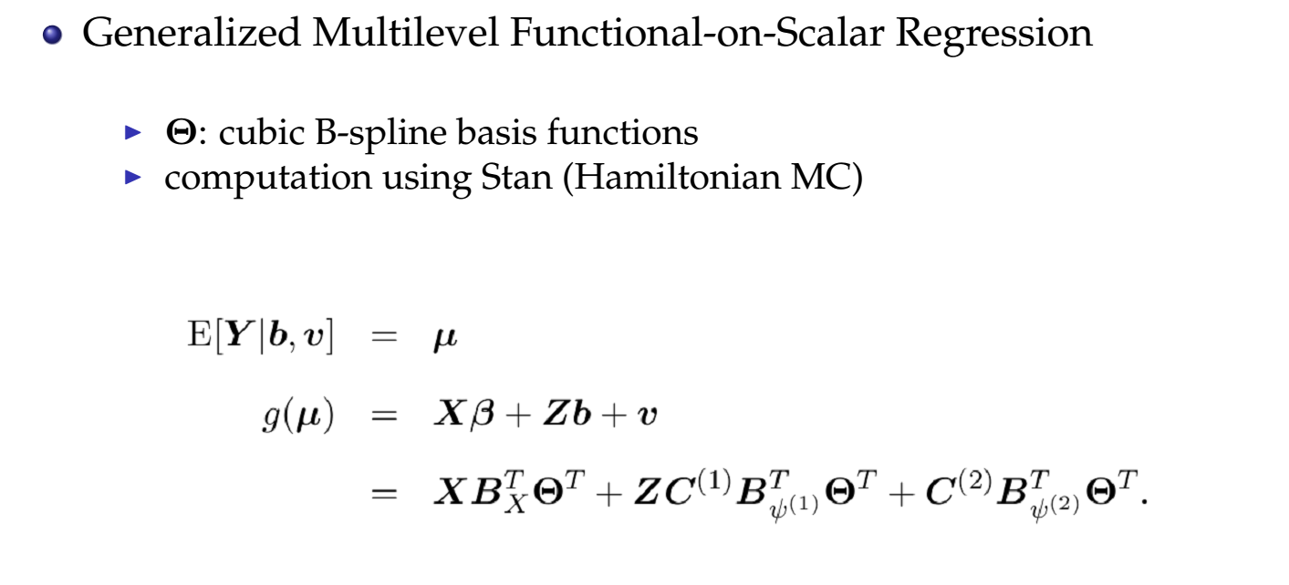

Slide 31
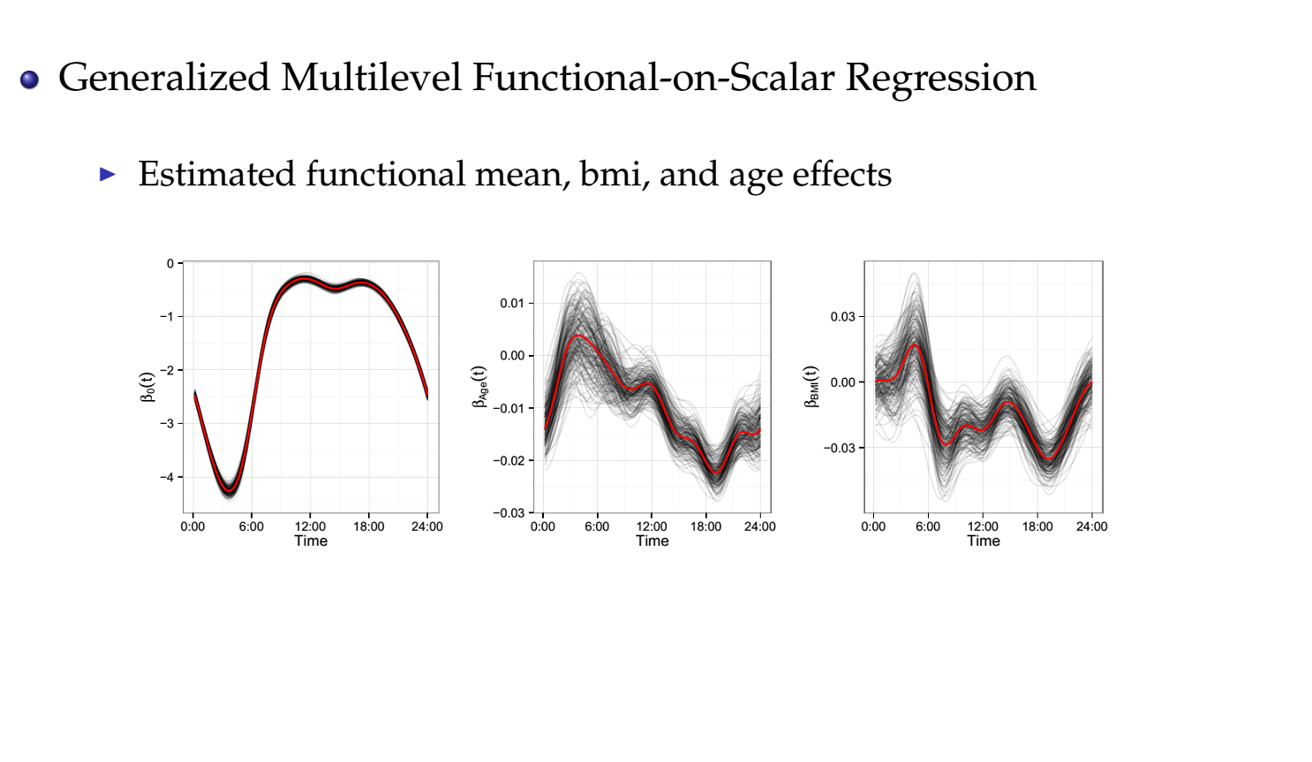

Slide 32
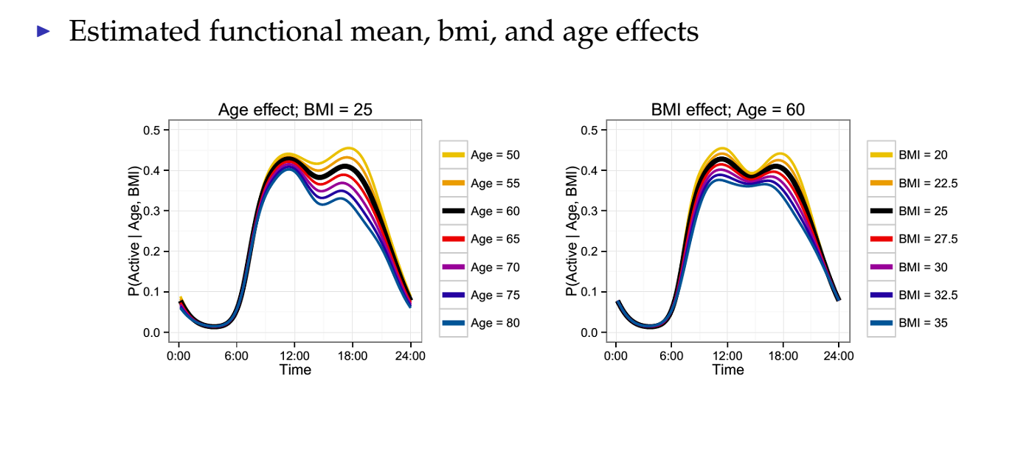

Slide 33
References:
Goldsmith, J., Zipunnikov, V, Schrack, J., Generalized Multilevel Function-on-Scalar Regression and Principal Component Analysis Biometrics, 71 (2), pp. 344-353

Slide 34
Registration of binary (0/1) actigraphy profiles

Slide 35
Registration of binary (0/1) actigraphy profiles

Slide 36
Registration of binary (0/1) actigraphy profiles

Slide 37
References:
Wrobel, J., Zipunnikov, V., Schrack, J. and Goldsmith, J., 2019. Registration for exponential family functional data. Biometrics, 75(1), pp.48-57.

